Slide 1
Recap
SUBQUERIES

Slide 2
WINDOW FUNCTIONS

Slide 3
Motivation
The aggregate functions perform calculations across a set of rows and return a single output row.
The following query uses the MAX() aggregate function to calculate the maximum salary of all employees in the company:
SELECT MAX(salary) AS max_salary
FROM employees;

Slide 4
Motivation continued
Remember that GROUP BY collapses the individual records into group. You cannot refer to any individual field after using GROUP BY because it is collapsed.
How will you create a report with employee names, salaries, and the maximum salary of all employees? You cannot do it with GROUP BY. To generate this kind of report, you need to use Window Functions.

Slide 5
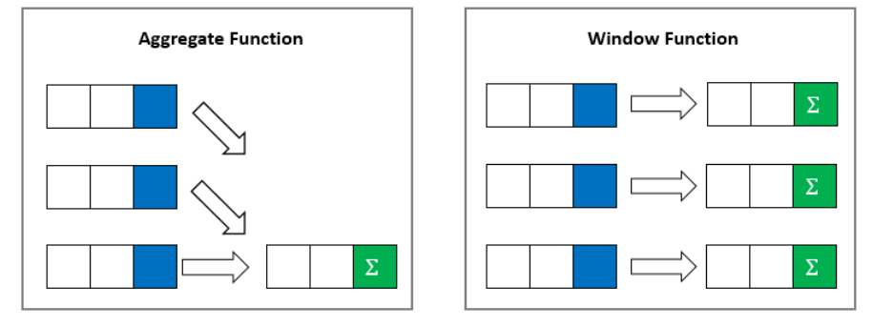
Motivation continued
The main difference between aggregate functions and window functions is illustrated in the following picture:

Slide 6
Motivation continued
The following query uses the MAX() as a window function. It returns the maximum salary of all employees along with the salary of each individual employee
SELECT first_name, last_name, salary
, MAX(salary) OVER() AS max_salary
FROM employees;

Slide 7
Window Function
The following query uses the MAX() as a window function and it returns a list of employee names, salaries, and the maximum salary in their departments.
SELECT first_name, last_name, department_id, salary
, MAX(salary) OVER(Partition BY department_id) AS max_salary
FROM employees;

Slide 8
Syntax
The syntax is as follows:
SELECT coulmn_name1
, window_function(cloumn_name2),OVER([PARTITION BY column_name1] [ORDER BY column_name3])
FROM table_name;
window_function= any aggregate, ranking or value functions
column_name1= column to be selected
column_name2 = column on which window function is to be applied
column_name3= column on whose basis partition of rows is to be done

Slide 9
Syntax continued
Window functions are a powerful feature of SQL. They allow us to apply functions like COUNT(), AVG(), COUNT(), MAX(), and MIN() on a group of records while still leaving the individual records accessible.
Window functions applies aggregate and ranking functions over a particular window (set of rows).
OVER clause is used with window functions to define that window.
PARTITION BY is used to split the result set into partitions on which window function is applied.
ORDER BY orders rows within those partitions into a particular order.

Slide 10
Aggregate Window Functions
SUM()
COUNT()
MAX()
MIN()
AVG()
MEDIAN()
STDEV(): standard deviation
VARIANCE()

Slide 11
Write a SQL query which returns employees first names, manager id, department id and minimum, maximum, total and average salary, and employee headcount for each department.
SELECT first_name, manager_id, department_id, salary
, MIN(salary) OVER( PARTITION BY department_id) AS min_salary
, MAX(salary) OVER( PARTITION BY department_id) AS max_salary
, SUM(salary) OVER( PARTITION BY department_id ) AS sum_Salary
, COUNT(*) OVER( PARTITION BY department_id) AS count_emp
, AVG(salary) OVER( PARTITION BY department_id ) AS avg_salary
FROM employees;

Slide 12
Rank Window Functions
RANK(): It assigns rank to each row within every partition. For the next rank after two same rank values, one rank value will be skipped.
DENSE_RANK(): It assigns rank to each row within every partition. For the next rank after two same rank values, consecutive integer is used, no rank will be skipped
ROW_NUMBER(): It assigns consecutive integers to each row within every partition. Within a partition, no two rows can have same row number.

Slide 13
Calculate row number, rank, dense rank of employees in the employees table according to salary within each department.
SELECT first_name, department_id, salary
, ROW_NUMBER() OVER(PARTITION BY department_id ORDER BY salary DESC) AS emp_row_no
, RANK() OVER(PARTITION BY department_id ORDER BY salary DESC) AS emp_rank
, DENSE_RANK() OVER(PARTITION BY department_id ORDER BY salary DESC) AS emp_dense_rank
FROM employees;

Slide 14
Value Window Functions
FIRST_VALUE(): It assigns the first value to each row within every partition.
LAST_VALUE(): It assigns the last value to each row within every partition.
LEAD(): It returns an offset (incrementally increased) value of an argument column. The offset amount can be defined in the query; its default amount is 1. The syntax is LEAD(column_name, offset, default value (optional) ). It retrieves the following rows.
LAG(): It is the opposite of LEAD(). It retrieves the preceding (previous) rows.

Slide 15
Find first value, last value, the following and the previous of salary for the employees in the employees table according to salary within each department.
SELECT first_name, manager_id, department_id, salary
, FIRST_VALUE(salary) OVER( PARTITION BY department_id ) AS first_salary
, LAST_VALUE(salary) OVER( PARTITION BY department_id ) AS last_salary
, LEAD(salary) OVER( PARTITION BY department_id) AS lead_salary
, LAG(salary) OVER( PARTITION BY department_id ) AS lag_salary
FROM employees;

